Slide 1
Centene Health Insurance Claim Forms
12/11/2019
Notes:
Frame the problem

Slide 2
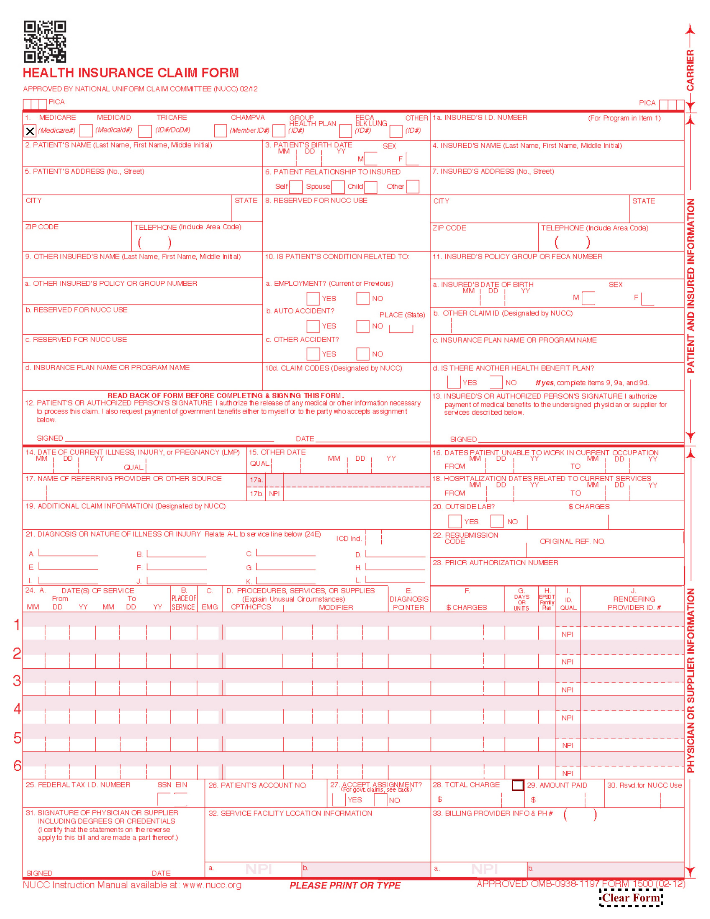
Business Opportunity
Notes:
The Business Opportunity that was presented was the need for a way to map filled values to their correct form label when scanner difficulties cause offsets and stretching of the form.

Slide 3
Agenda
Initial Investigation
Rotate, Crop, Resize, and Overlay Filled form and Blank Form
Duplicate Existing Method Using Intersection of Bounding Boxes
K-Nearest Neighbor Model Using Top-Left Corner of Text
K-Nearest Neighbor Model Using Center of Text
Methods Comparison

Slide 4
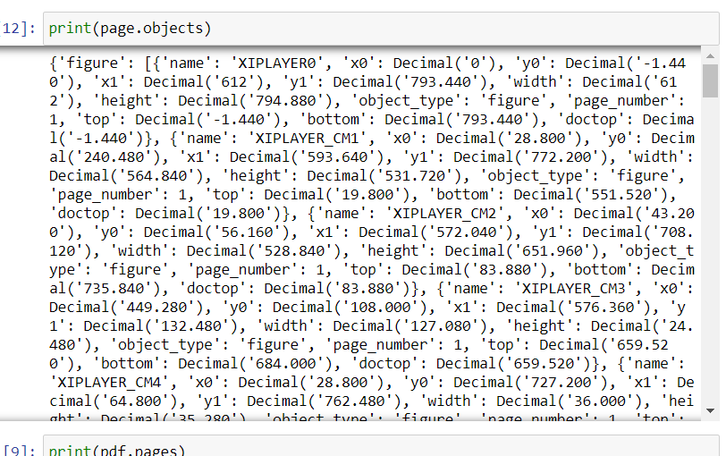
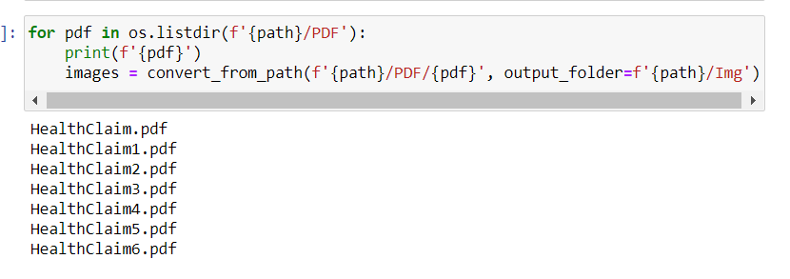
Initial Investigation
Notes:
Looking at the objects that were pulled from the pdfplumber script it is clear to see that there is no useful structure being pulled
Therefore pdf2image script used to just separate the pages of the pdf into invidual image files

Slide 5
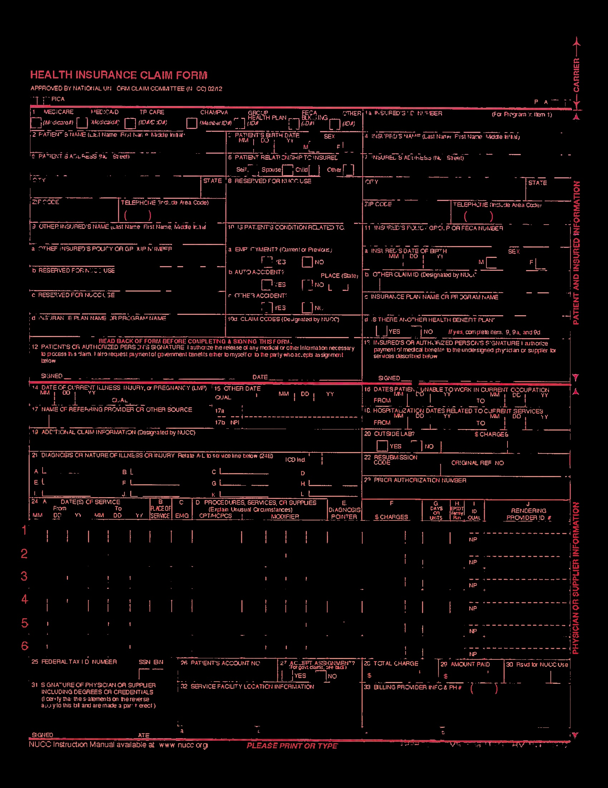
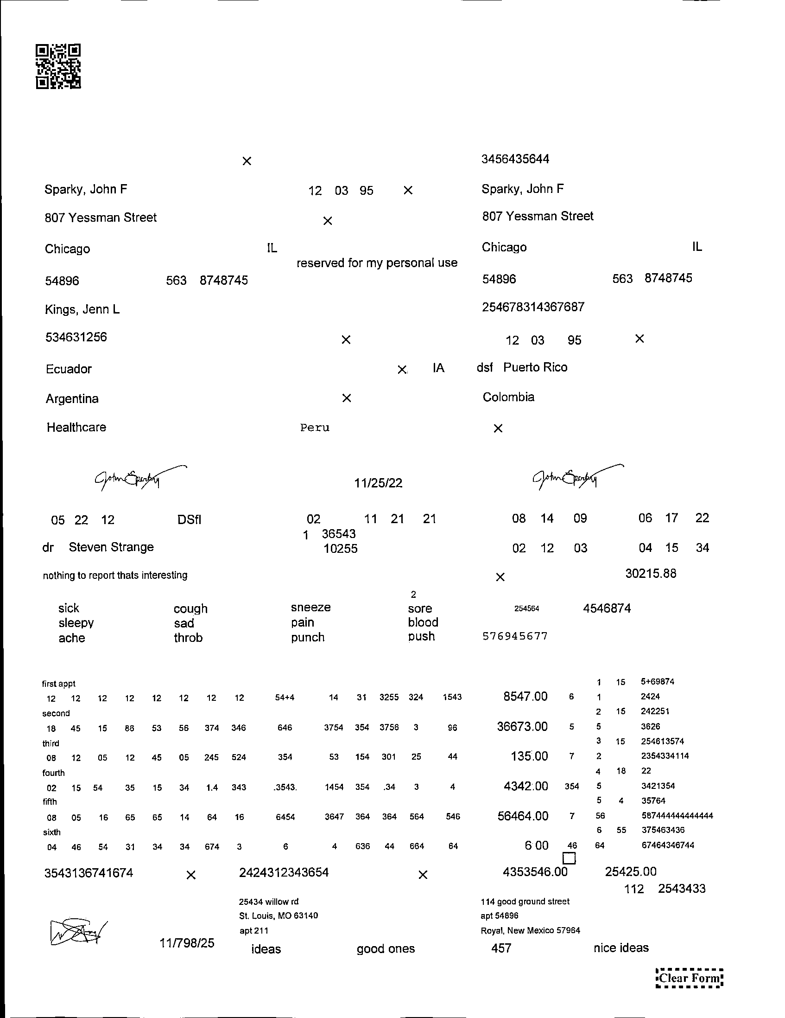
Initial Investigation
Notes:
Finally to try and get rid of the background and mimic the prod data masking was attempted and abandoned due to the difficult of matching the red exactly

Slide 6
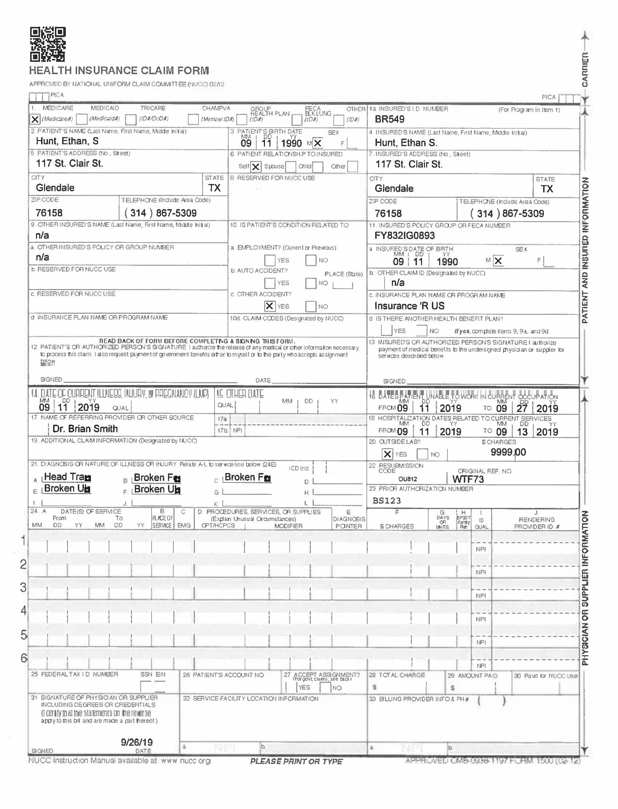
Rotate, Crop, Resize, and Overlay Filled Form and Blank Form

Slide 7
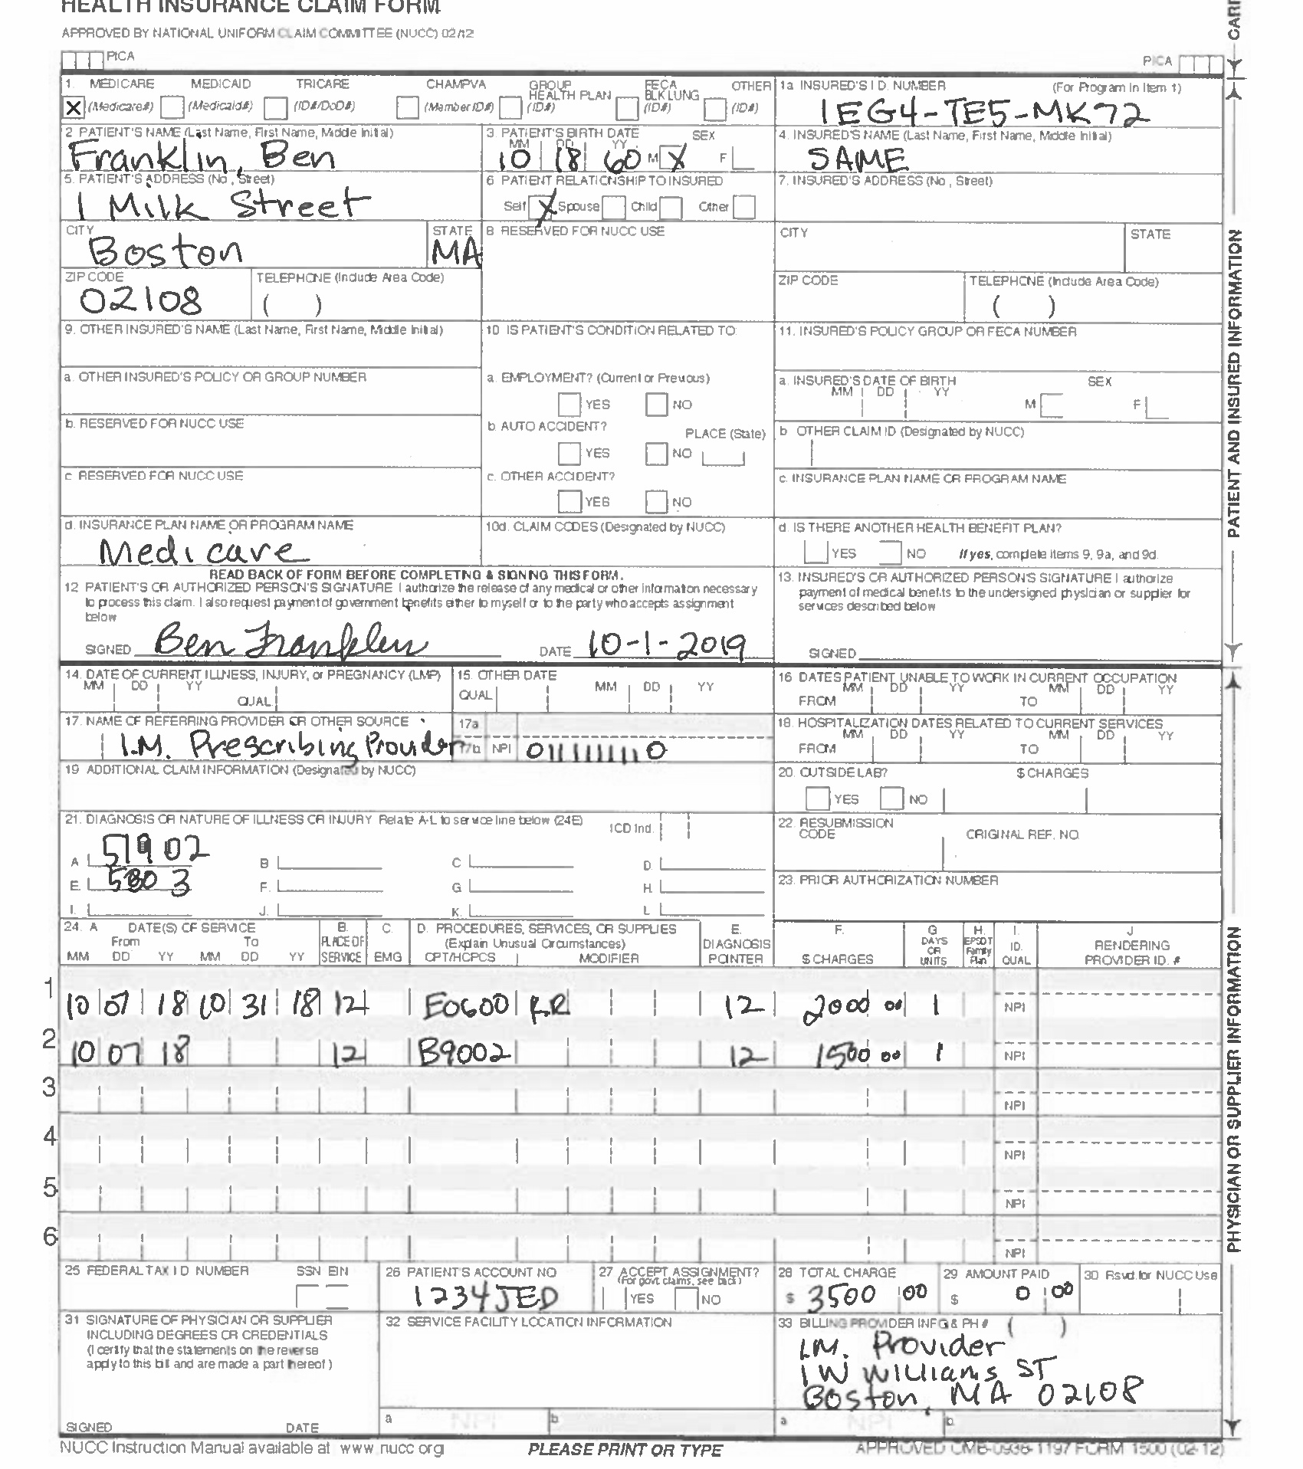
Rotate, Crop, Resize, and Overlay Filled Form and Blank Form

Slide 8
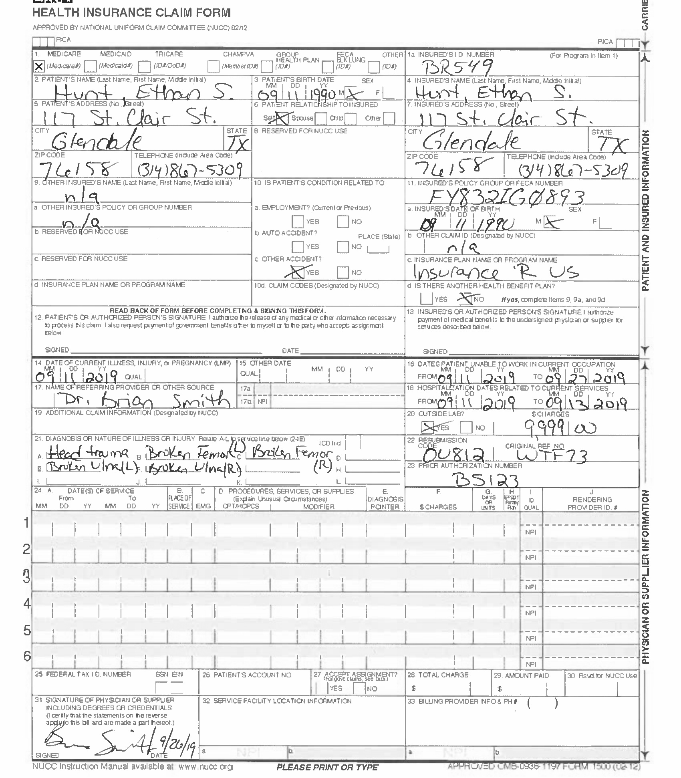
Rotate, Crop, Resize, and Overlay Filled Form and Blank Form

Slide 9
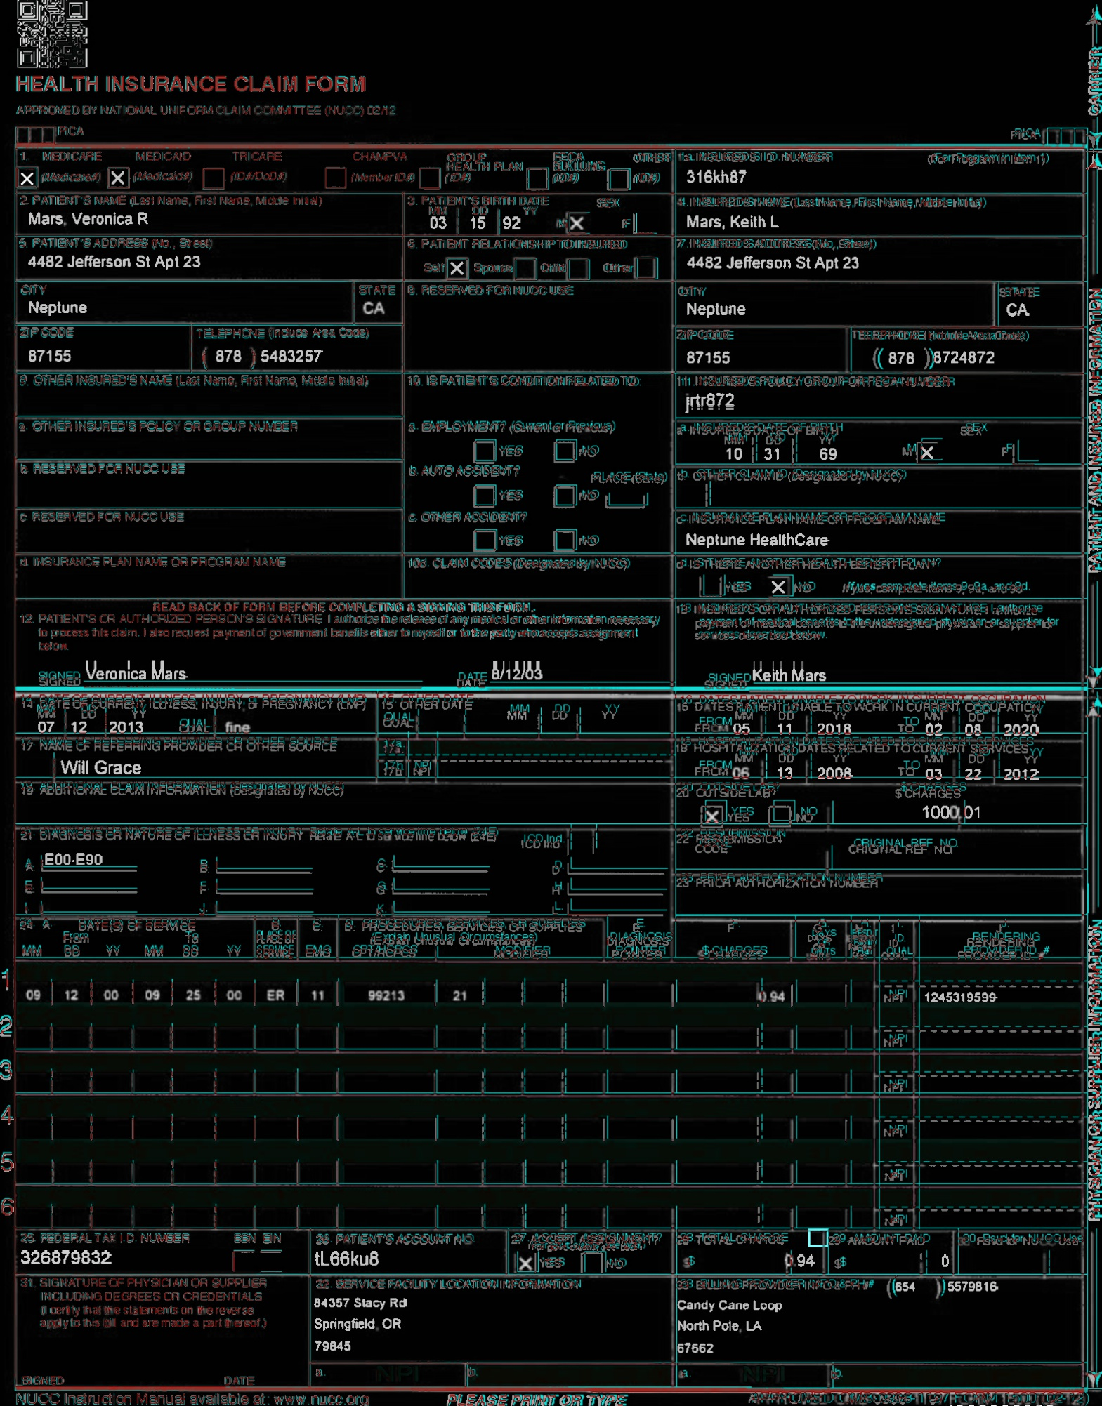
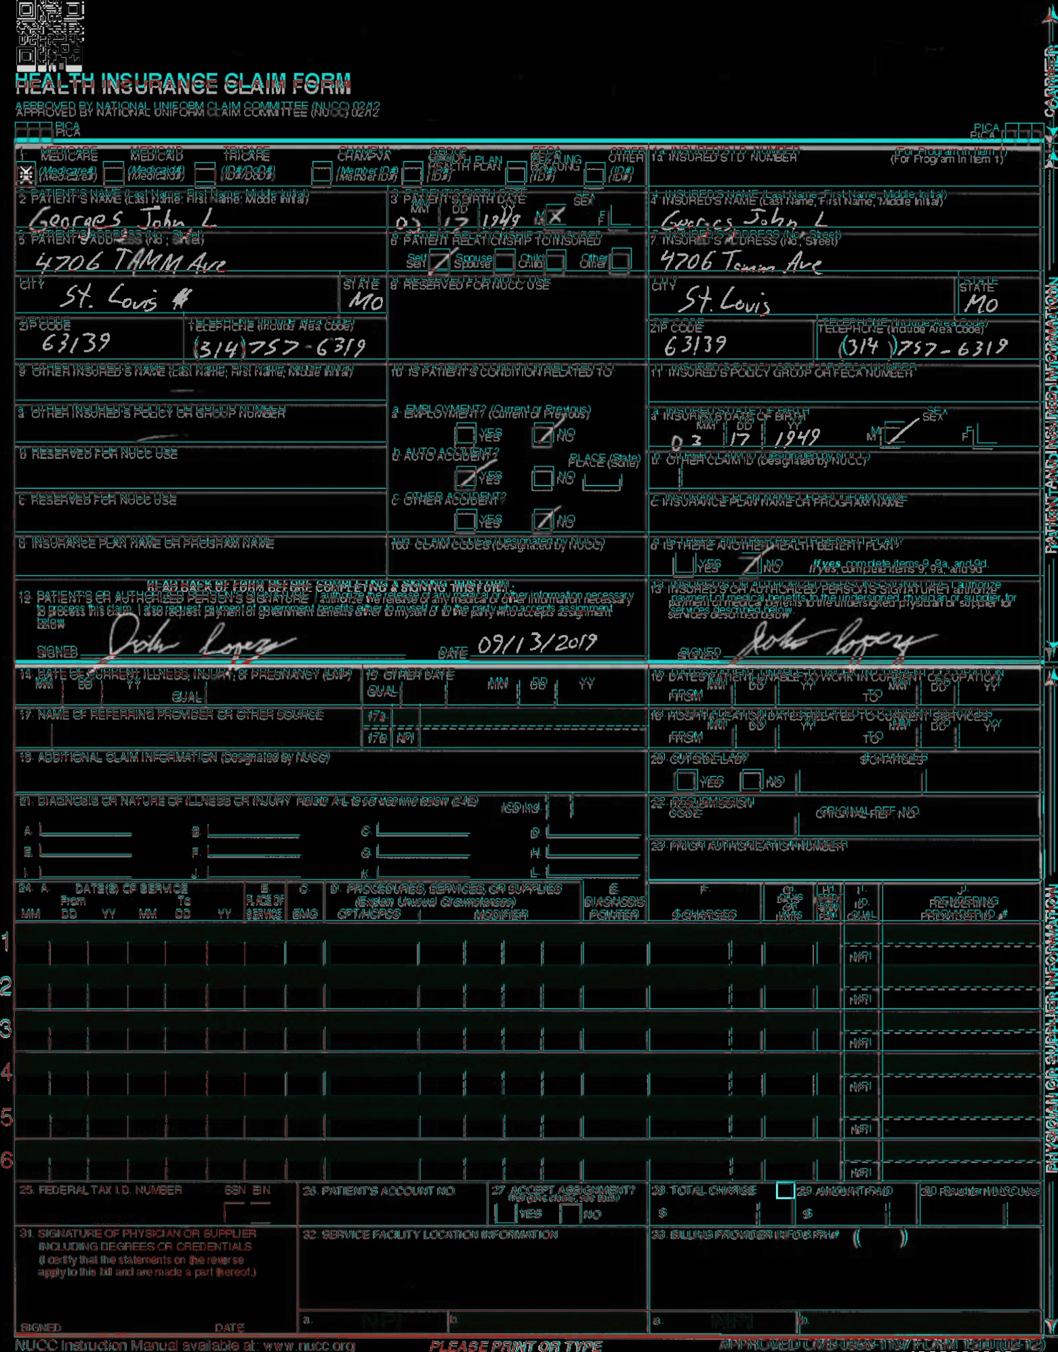
Rotate, Crop, Resize, and Overlay Filled Form and Blank Form
Notes:
Result from the transformations and then overlaying the forms on top of each other
May not work since cropping is done based on the red form background

Slide 10
Duplicate Existing Method Using Intersection of Bounding Boxes
Cost Associated with text extraction (Amazon Textract)
Lack of Bounding Boxes
Cost of manually creating bounding boxes
Notes:
Three issues arose moving to the next stage of the project and they were

Slide 11
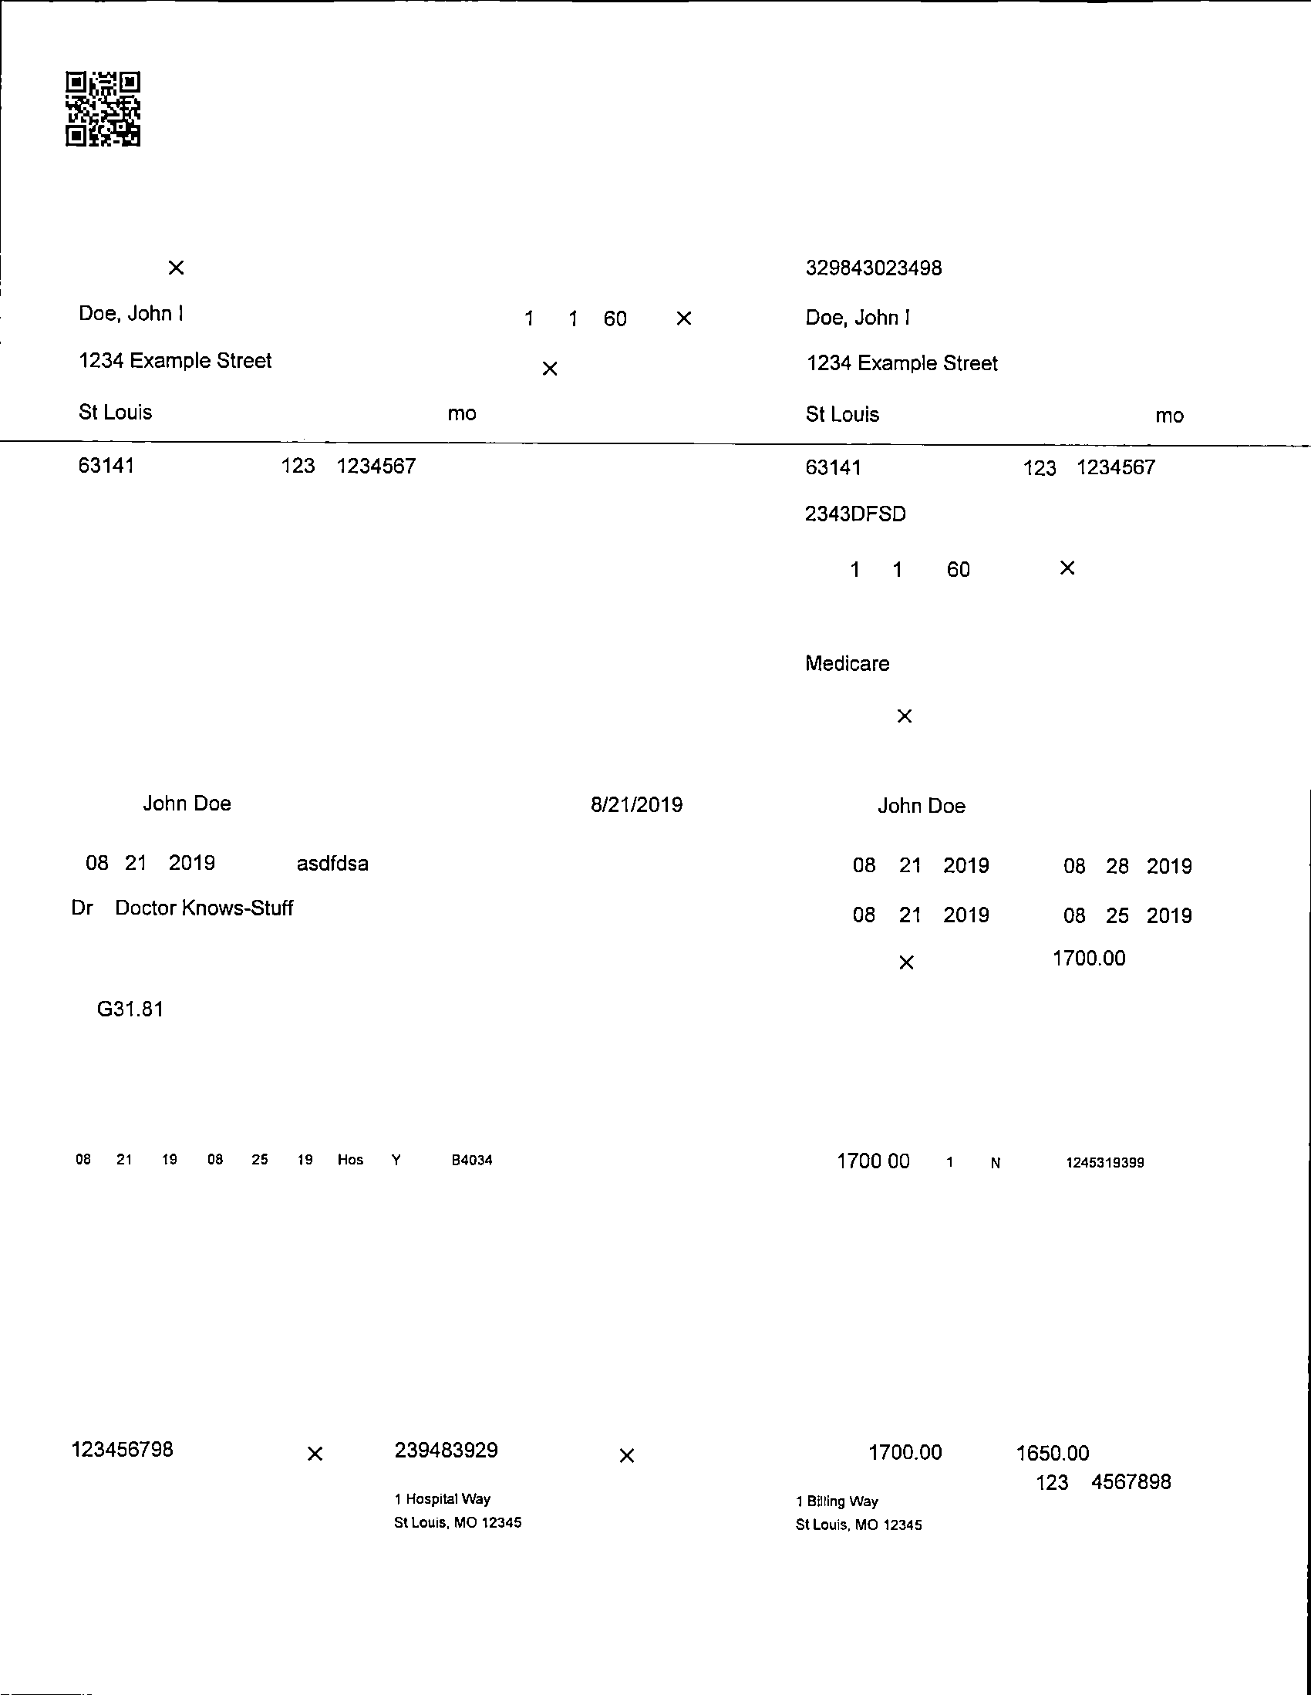
Duplicate Existing Method Using Intersection of Bounding Boxes
Notes:
White pages solved the first two problems
No longer needed a textraction software and could now programmatically bound the text because the noise created by the form background has been removed
Unfortunately no solution to the third one so I had to manually label each individual box

Slide 12
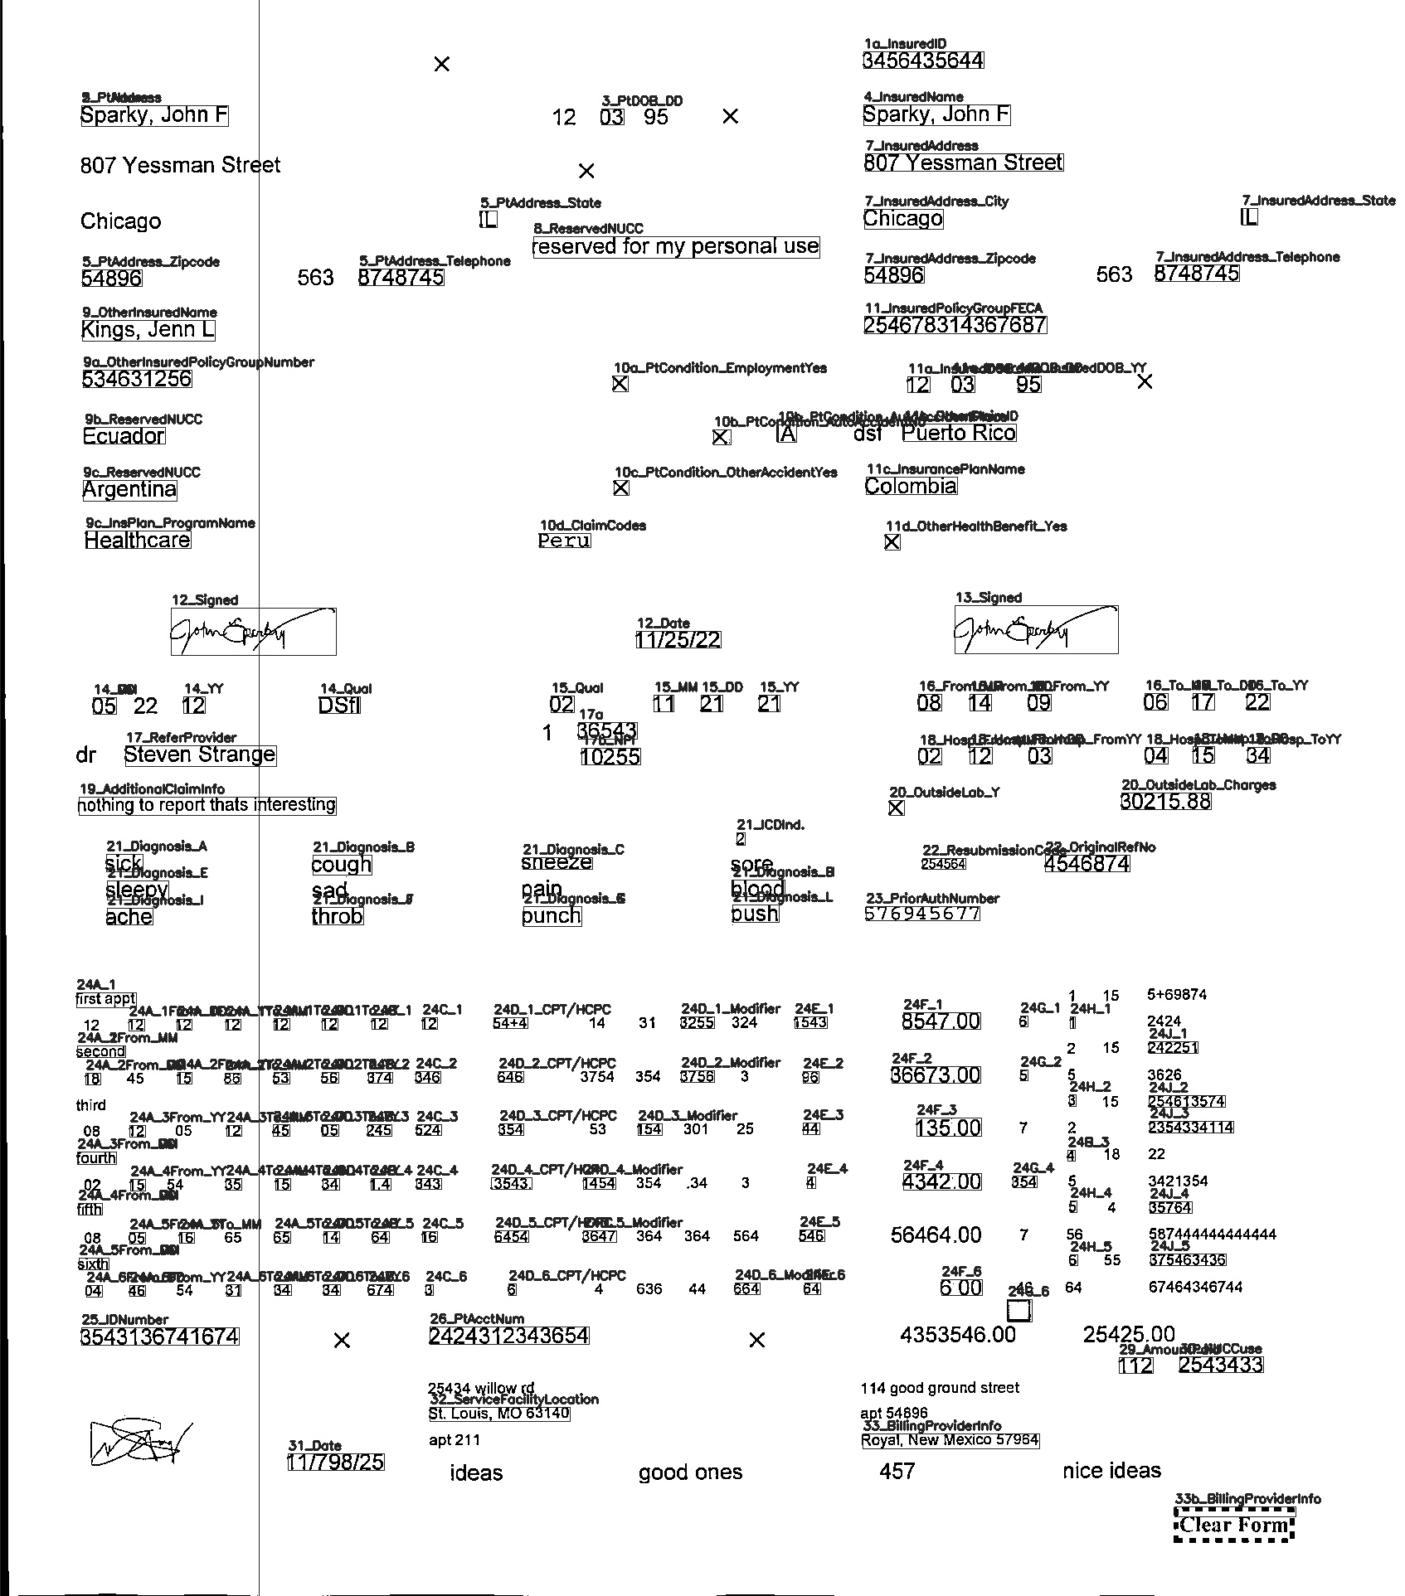
Duplicate Existing Method Using Intersection of Bounding Boxes
Notes:
Three issues arose moving to the next stage of the project and they were

Slide 13
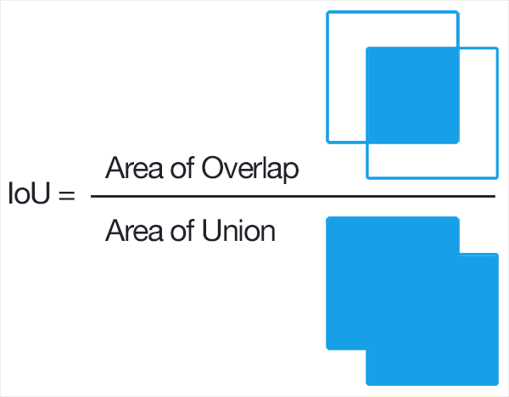
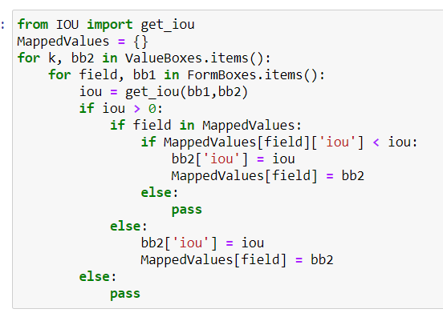
Duplicate Existing Method Using Intersection of Bounding Boxes
Notes:
The code on the screen then computes the IOU by comparing the top left and bottom right corners of the filled form and blank form fields
Don’t worry about the code this is what IOU represents
75% of boxes got a label

Slide 14
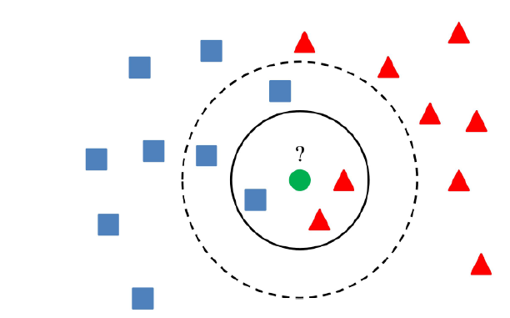
K-Nearest Neighbor
Supervised Machine Learning
Notes:
Three issues arose moving to the next stage of the project and they were

Slide 15
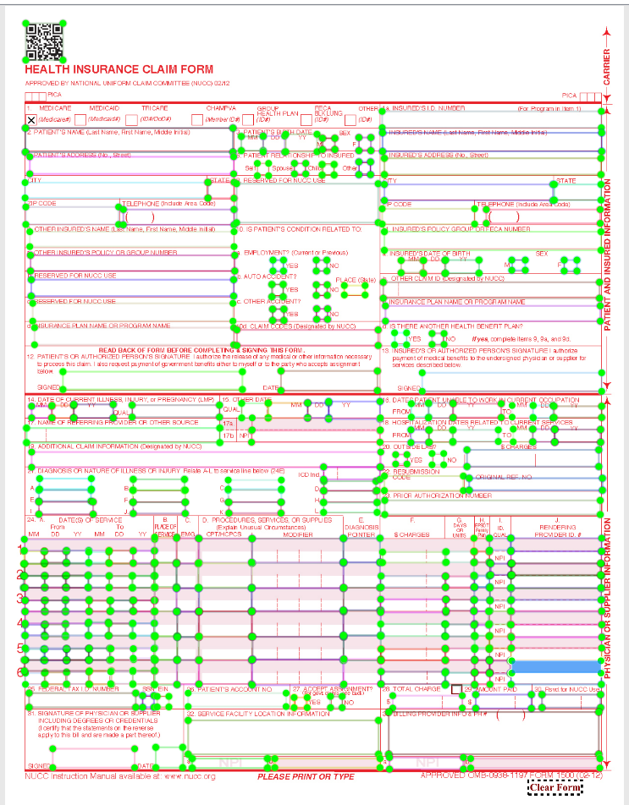

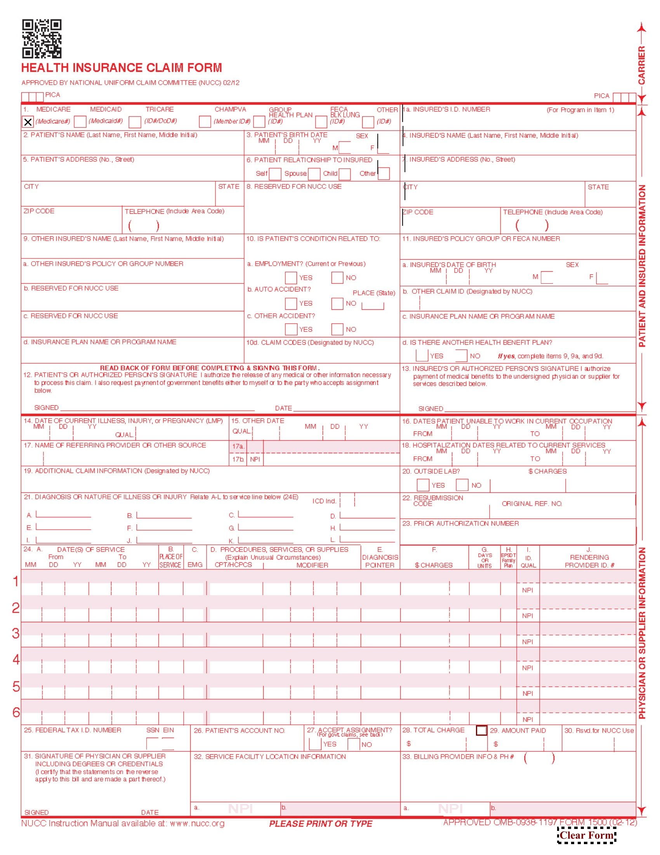
K-Nearest Neighbor Top-Left Corner
Accuracy | 99.69% | 1 neighbor
Notes:
Three issues arose moving to the next stage of the project and they were

Slide 16
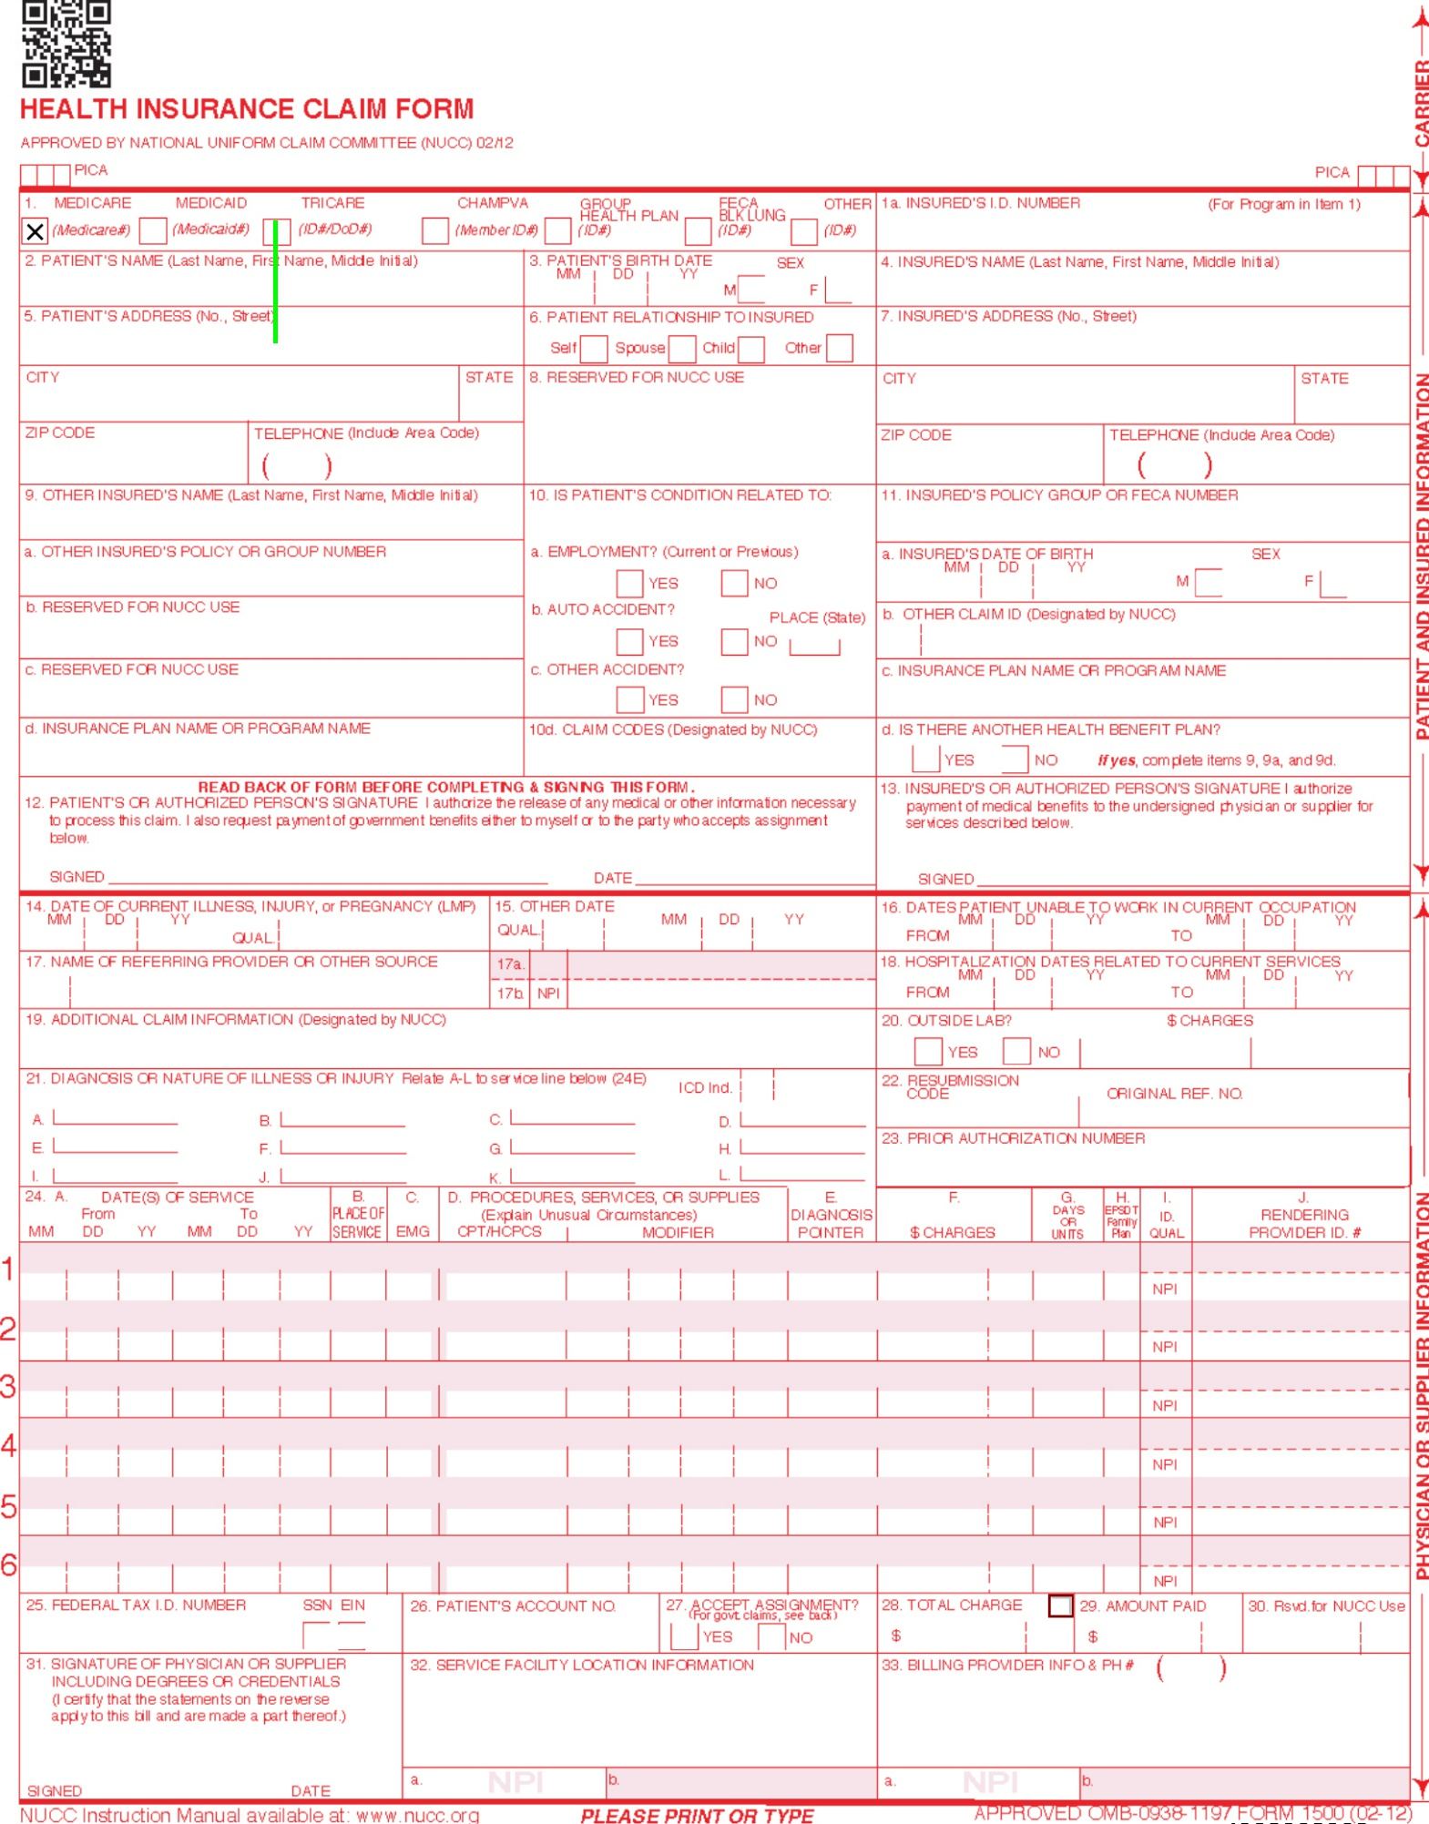
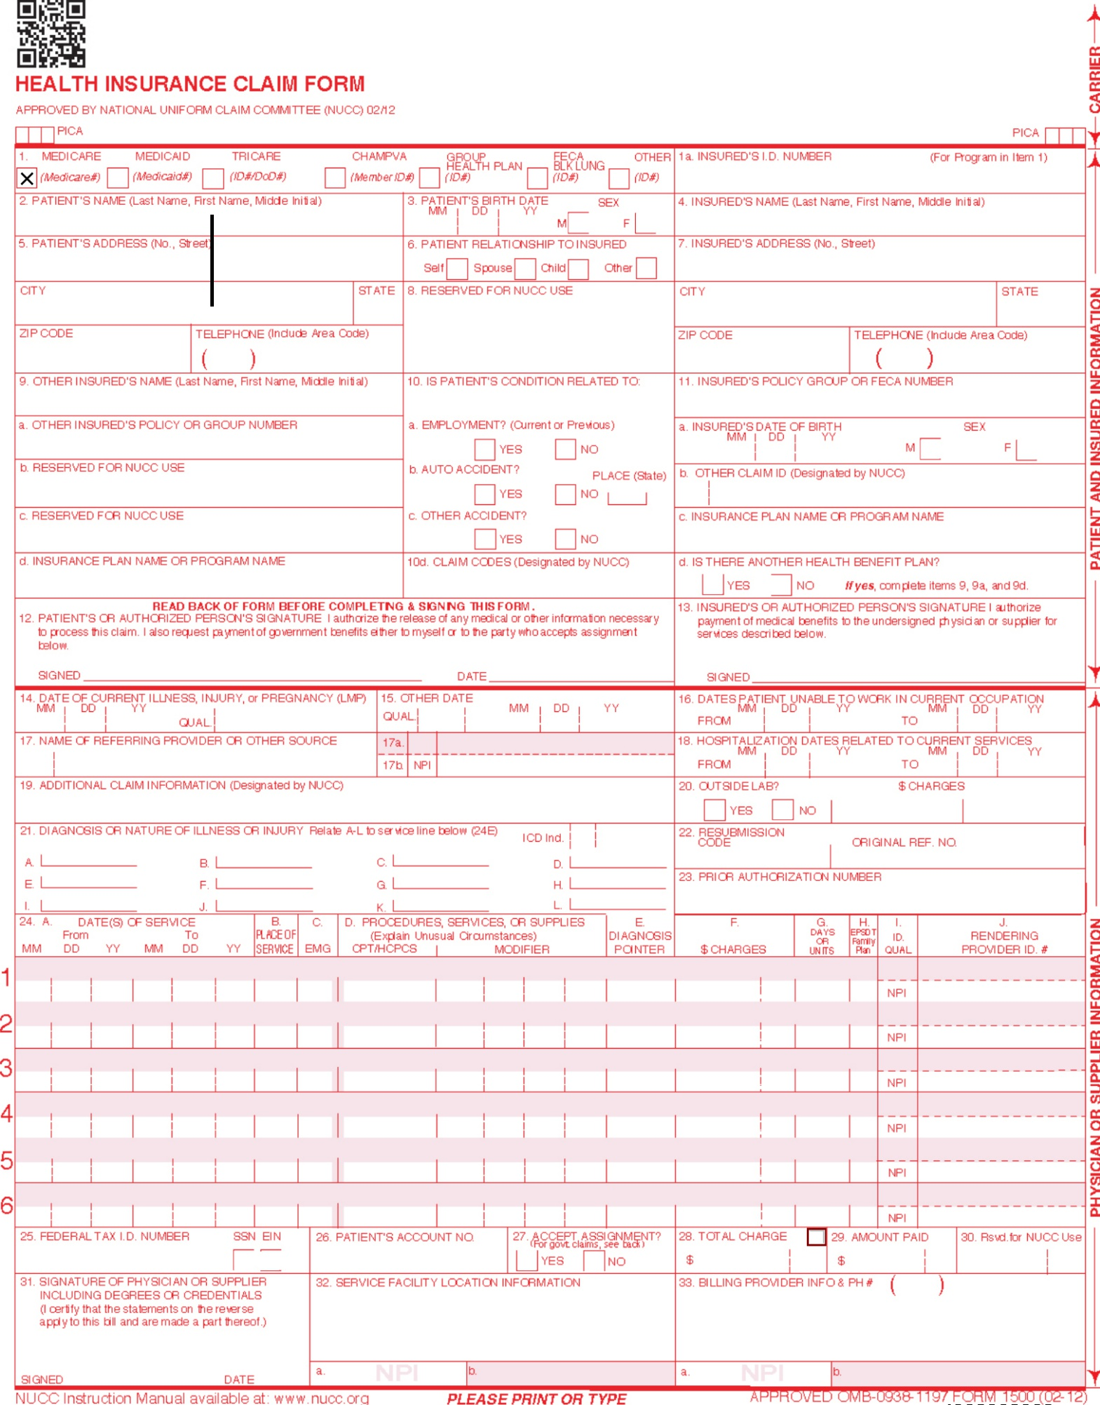
K-Nearest Neighbor Center Corner
Accuracy | 94.47% | 17 neighbors
Notes:
Add in more slides clarifying accuracy score

Slide 17
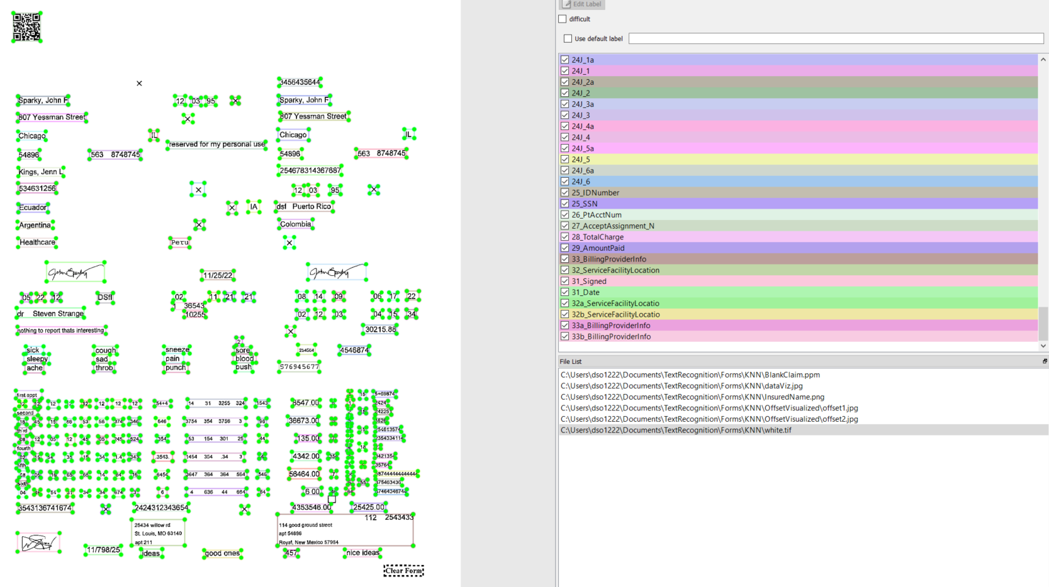
Methods Comparison

Slide 18
Methods Comparison
Method | Accuracy
IOU | 97.63%
Center | 55.92%
Left | 42.65%

Slide 19
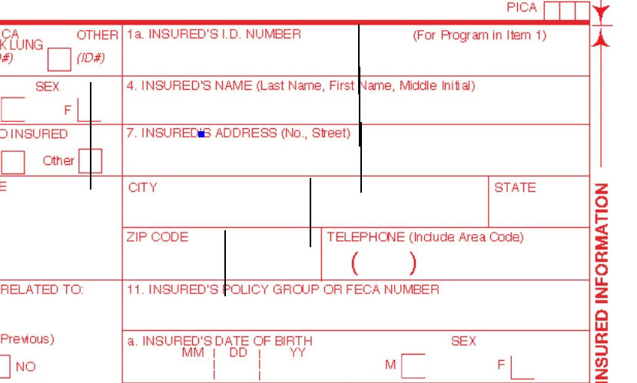
Methods Comparison

Slide 20
Future Iteration
Better training data should raise the accuracy of the KNN
Text Classification to identify the category of text being extracted
(names vs. address vs. cpt)

